Slide 1


THE IA
IA – 3 – Criteria B
https://youtu.be/3t5gDW8jh6g?si=-zk6cXC7zW7yluSJ

Slide 2
CRITERIA B – PLANNING
150 words recommended
Criteria A has TWO parts
Decomposition of problem scenario
Plan to address success criteria

Slide 3
DECOMPOSITION OF PROBLEM SCENARIO
Breaking down your problem scenario into smaller, more manageable sub-problems or components
This can be effectively done using diagrams

Slide 4
DECOMPOSITION OF PROBLEM SCENARIO
Identify the main components of your solution, as well as its functional parts
Once they have been identified, divide each component into smaller, specific tasks
Reduce complexity, make easier to tackle
How to illustrate this
Use Case Diagram with flow charts, data flow diagrams, etc.
Procedural Programs: Flow charts to break down task into modules
Object-oriented Programs: identify and describe objects (NOT UML DIAGRAMS YET)
Database Programs: identify and describe data, and data processing needed (NOT ENTITY RELATIONSHIP DIAGRAMS YET)

Slide 5
PLAN TO ADDRESS SUCCESS CRITERIA
Address requirements in terms of the success criteria
Include a proposed ‘chronology’ for the steps involved in the planning, designing, developing, testing, and evaluating the solution
This plan can come in different forms, such as GANTT and AGILE charts
Plan may include research, such as using existing code libraries

Slide 6
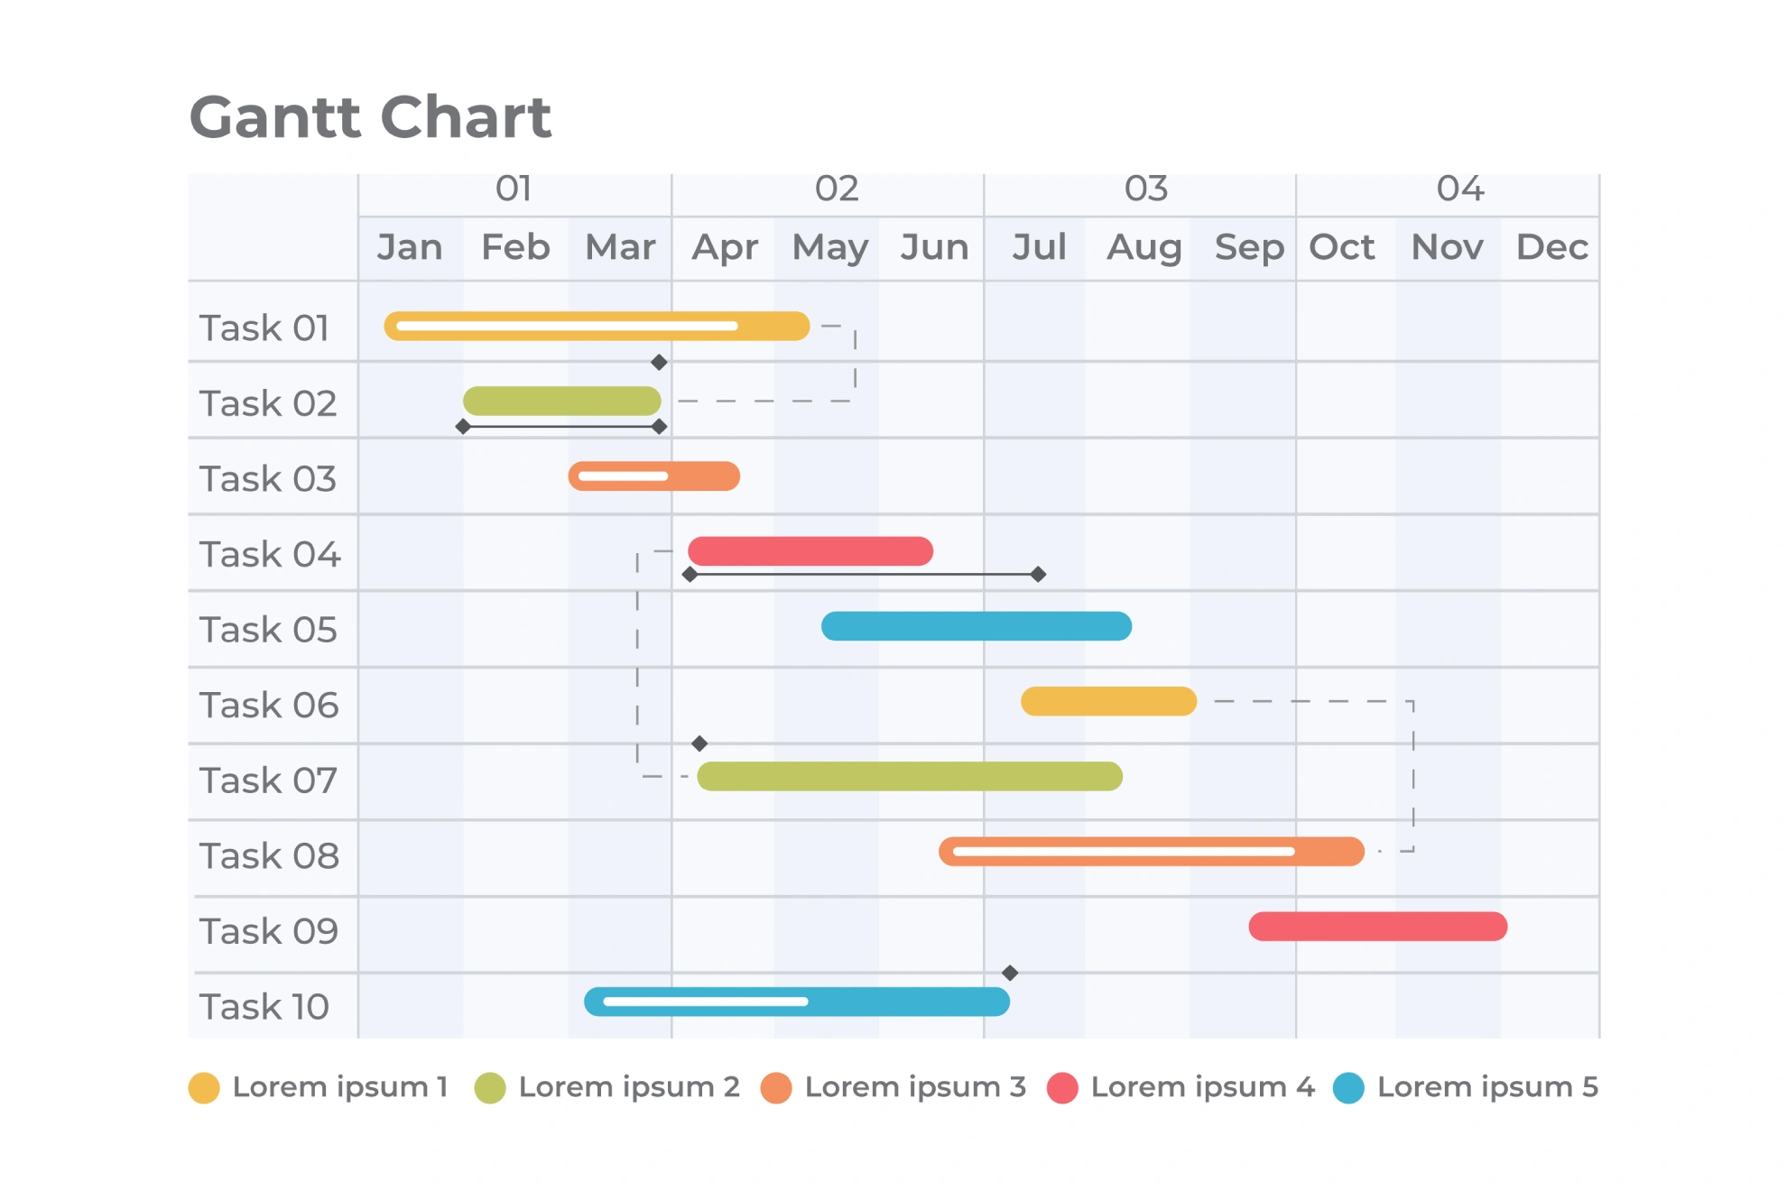
PLAN TO ADDRESS SUCCESS CRITERIA
GANTT chart
much good
should use

Slide 7
PLAN TO ADDRESS SUCCESS CRITERIA
Make sure you’ve decomposed your problem FIRST
Your chronological plan depends on it
Consider the following in your plan
Task order and dependencies (what relies on what being done first)
Success criteria to address all requirements
Subtasks breaking down major activities into steps for planning, designing, developing, testing, evaluating
Timing, limitations, resources to ensure allocations are realistic
Planning time for research to integrate it into the plan
This is NOT a process journal
This should be written BEFORE you start the next criteria

Slide 8
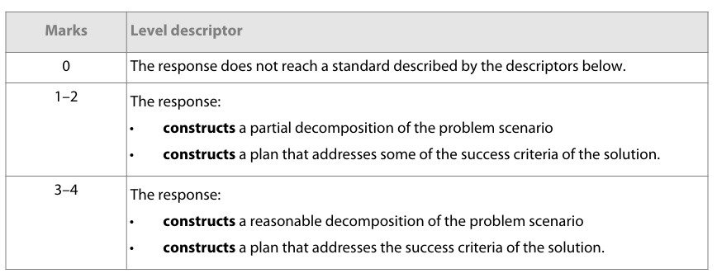
MARKSCHEME
Markscheme

Slide 9
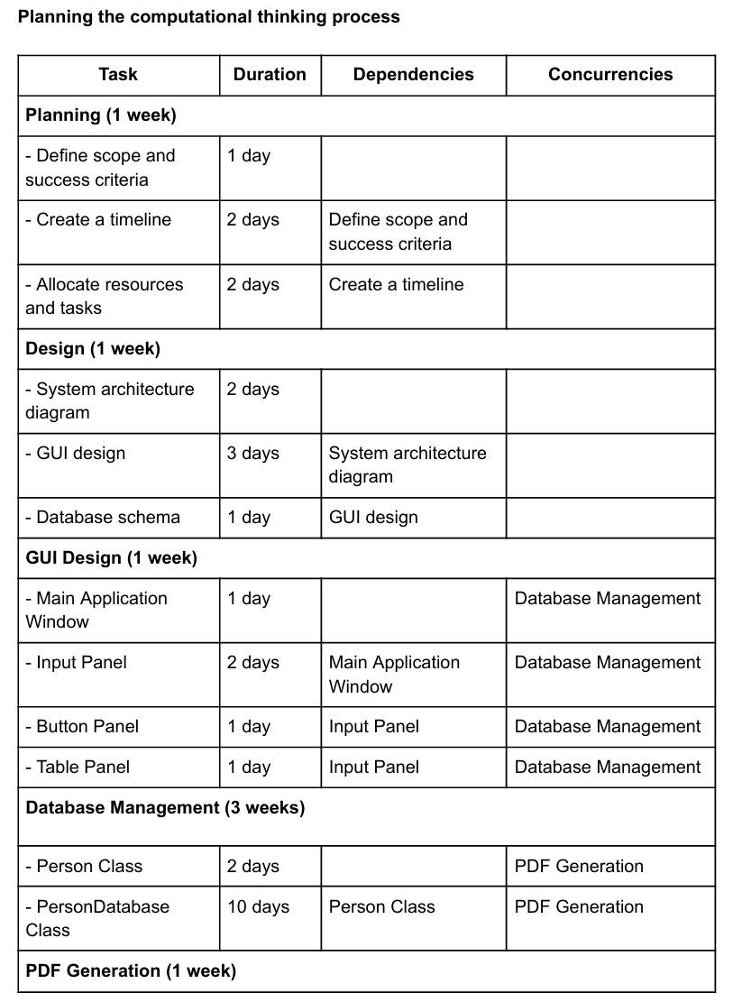
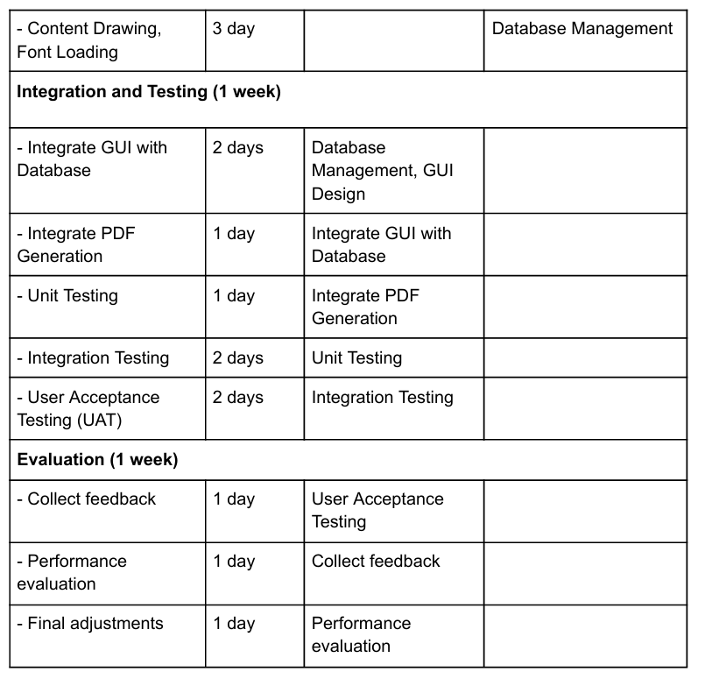
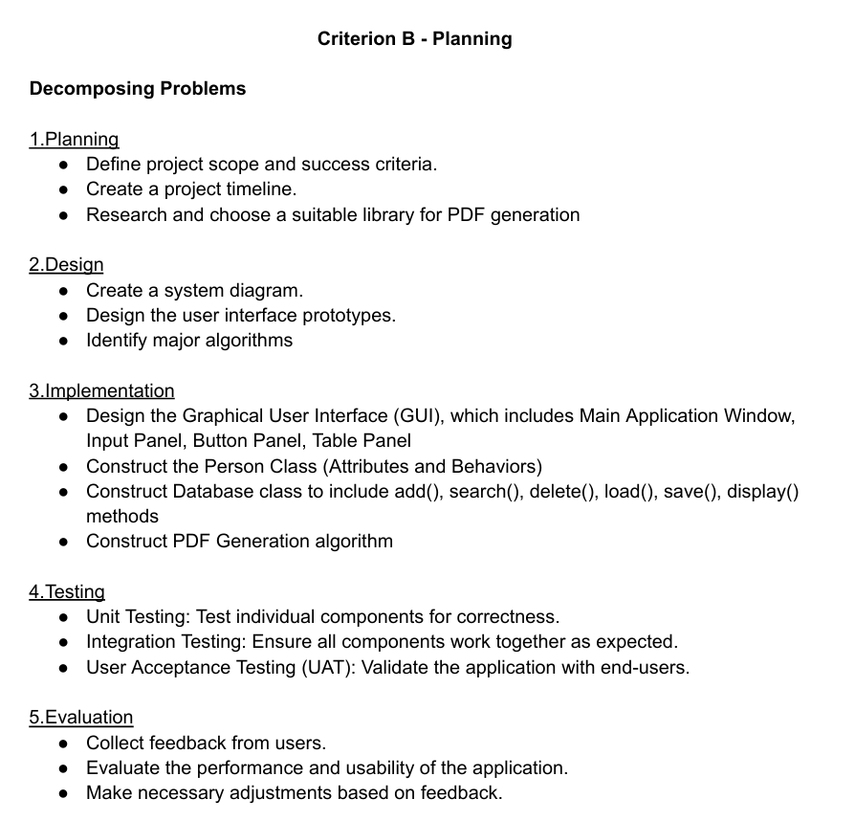
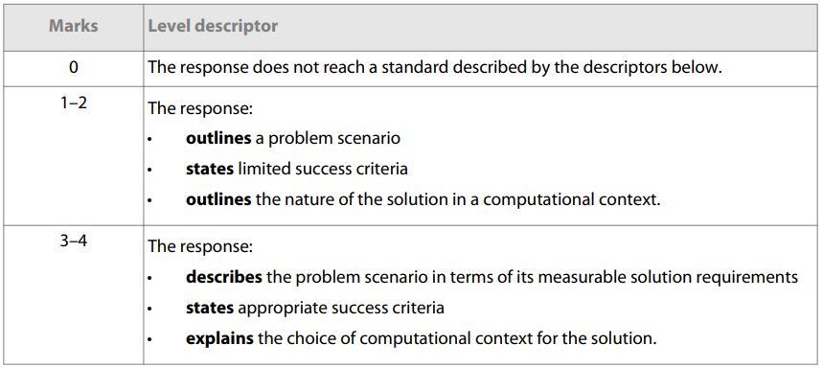
LET’S DO SOME MARKING
What do we think this got?

Slide 10
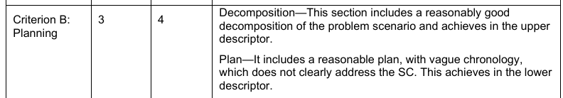
LET’S DO SOME MARKING
It got a 3 out of 4
Birthday card generator

Slide 11
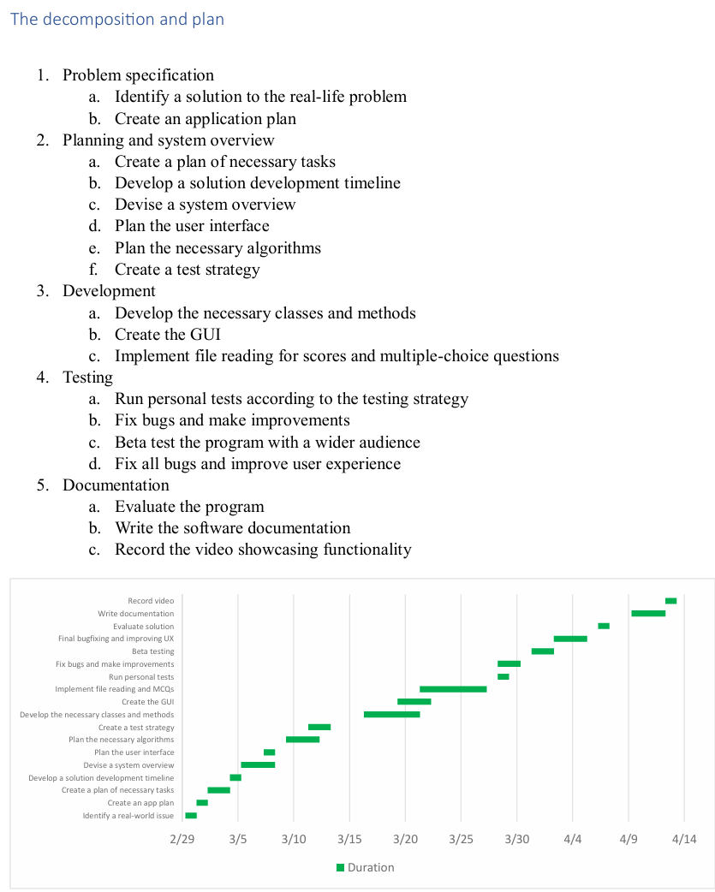
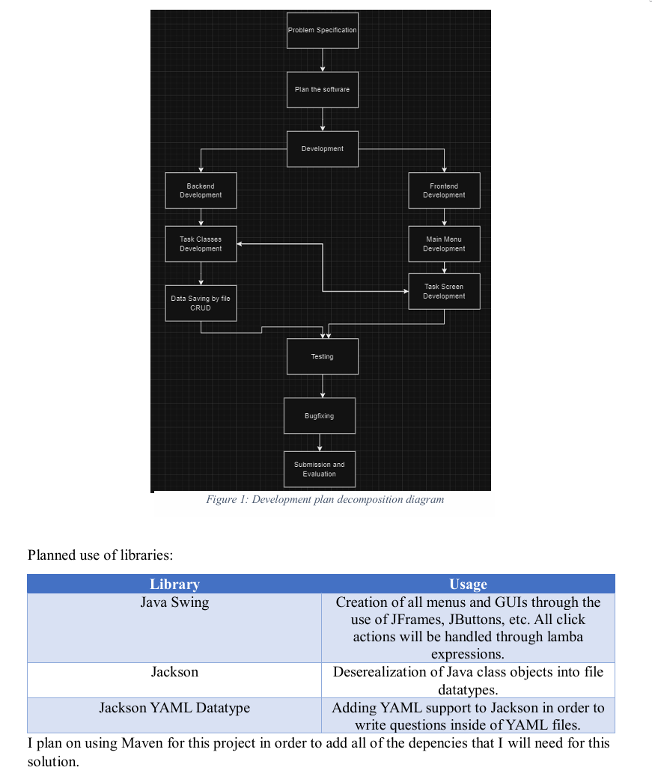
LET’S DO SOME MARKING
How about this?

Slide 12
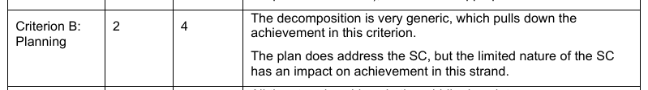
LET’S DO SOME MARKING
A mere 2 out of 4
Quiz Game Example

Slide 13
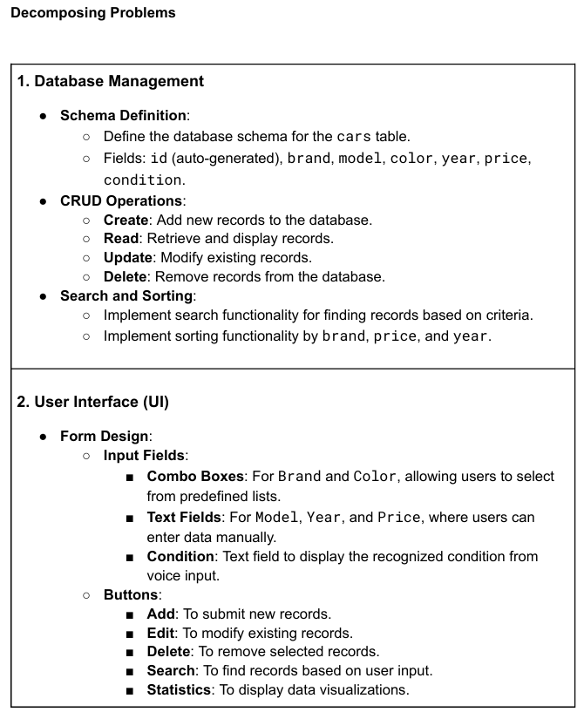
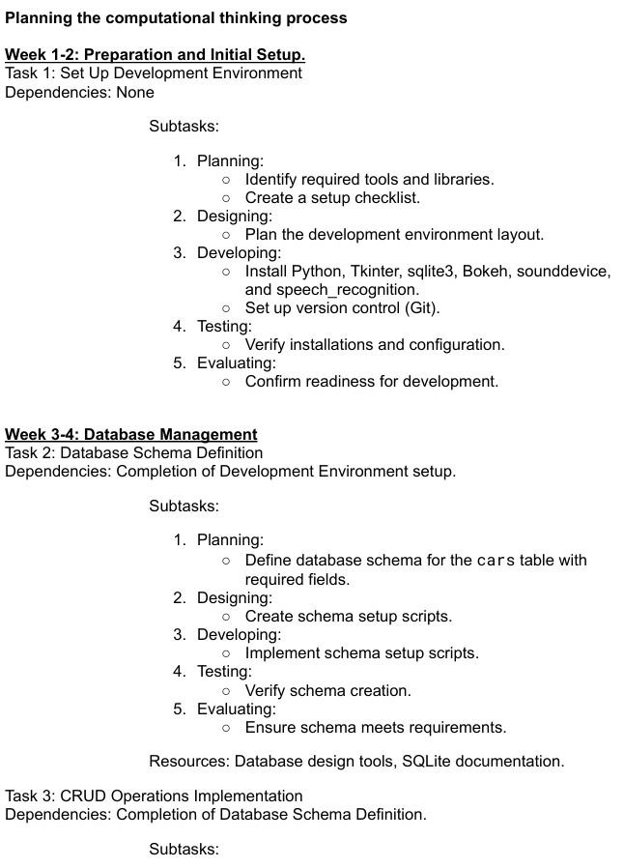
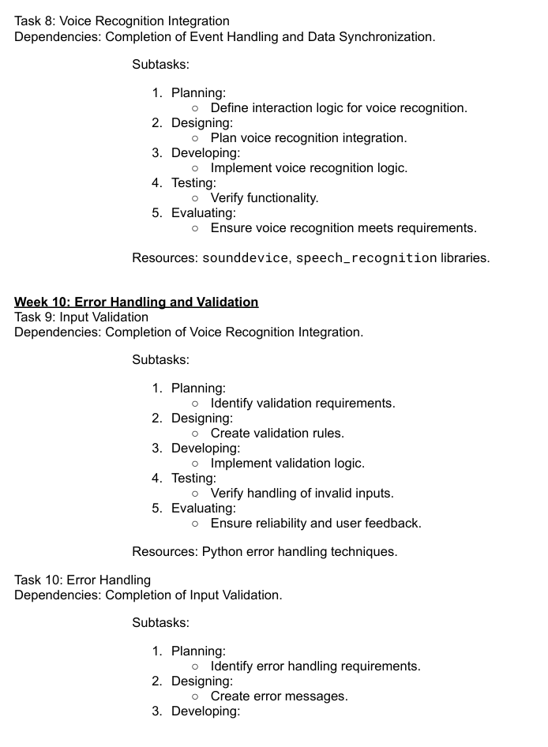
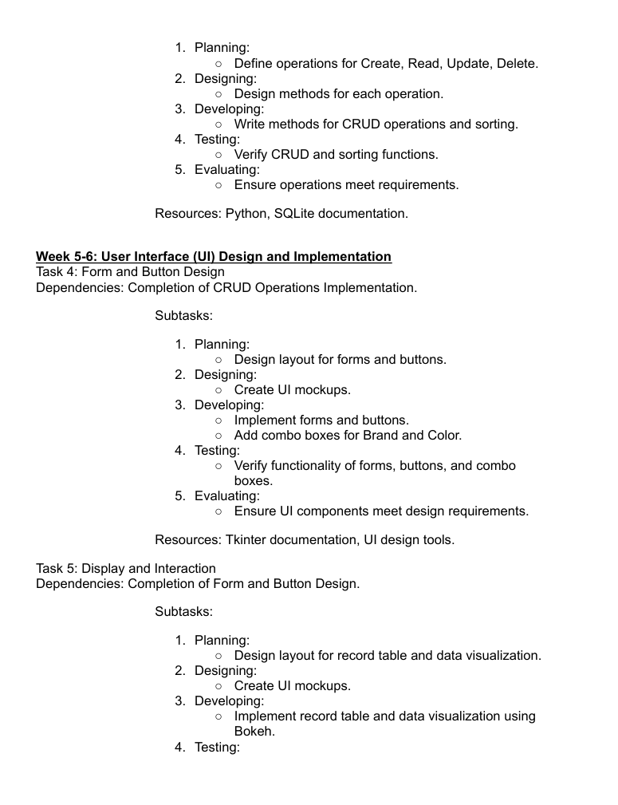
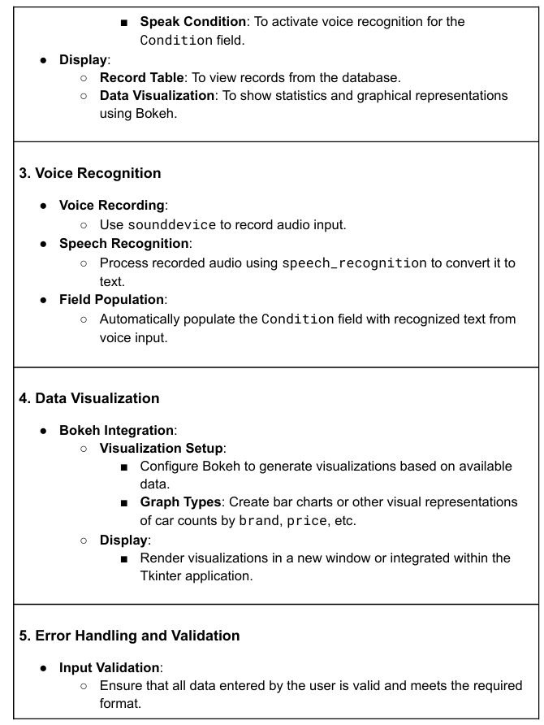
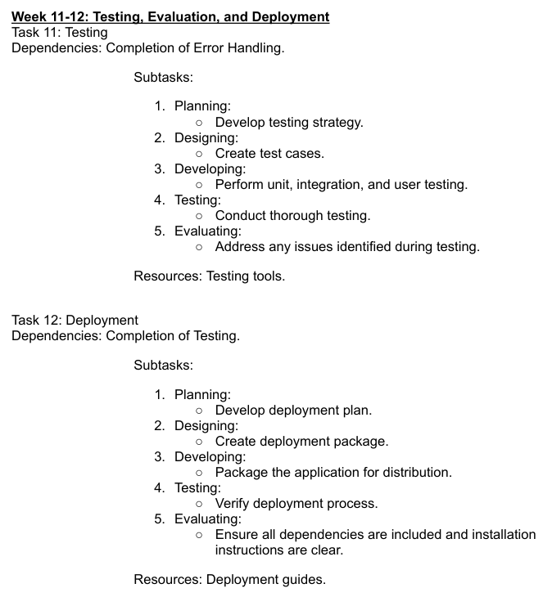
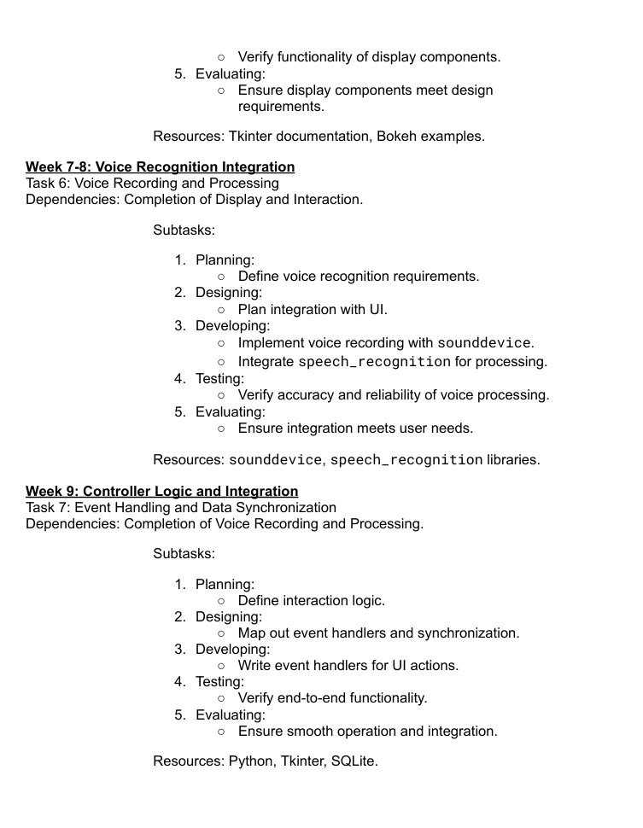
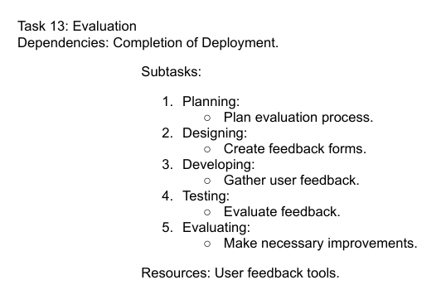
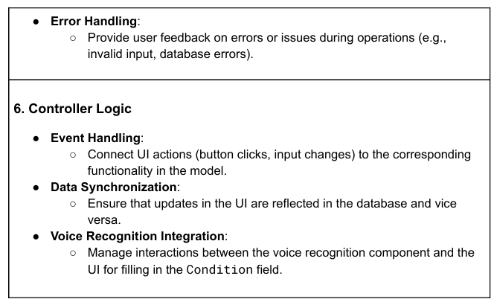
LET’S DO SOME MARKING
Keep the train rolling!

Slide 14

LET’S DO SOME MARKING
Yeah, this one got a 4/4
You might notice this is much more than 150 words
yeah
Car management example

Slide 15
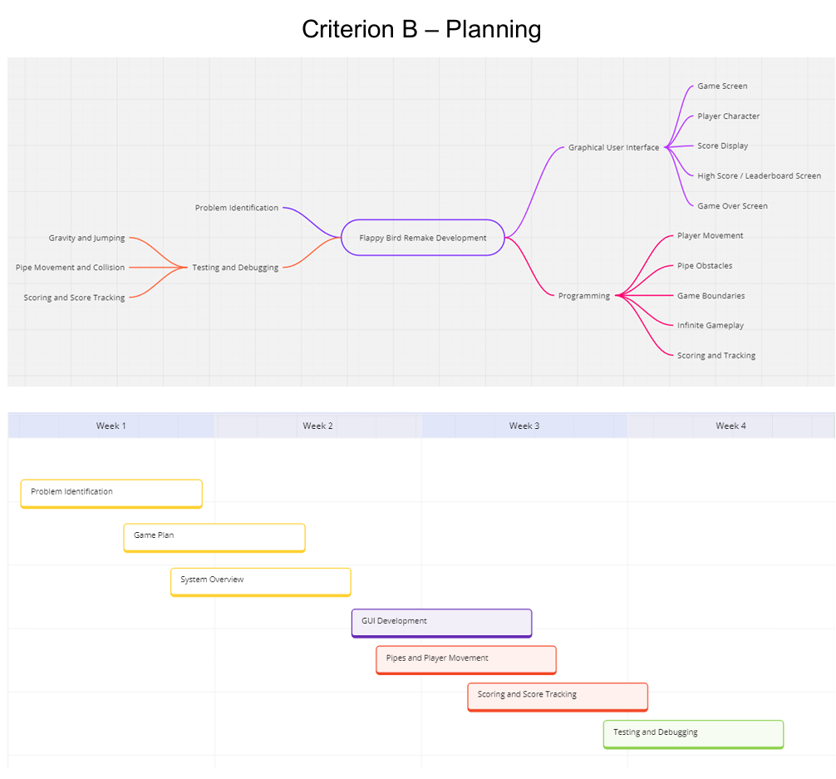
LET’S DO SOME MARKING
One final one!

Slide 16
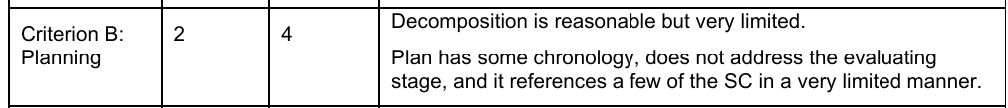
LET’S DO SOME MARKING
One final one!

Slide 17
“WORD COUNT”
So, even though, it’s only 150 words, you’ll notice that you need a lot more than that to get a good grade
This reveals a truth about the CS IA – the word limit is NOT 2000, it’s 2000 + however much information you can hide in diagrams
Recall that diagrams and tables don’t count towards your word count
I would strongly recommend writing much more than only 150 words and cramming more into your diagrams, timelines, etc.

Slide 18
CRITERIA B - ASSIGNED
Check GitHub for the Criteria B document to know what to write and create for your presentation – WS IA-4 – Criteria B

